Slide 1
29 – Clean Code – Design Patterns – SMC Parser and Builder Pattern
Based on the CleanCoders videos by Uncle Bob Martin
Rupert Waldron

Slide 2
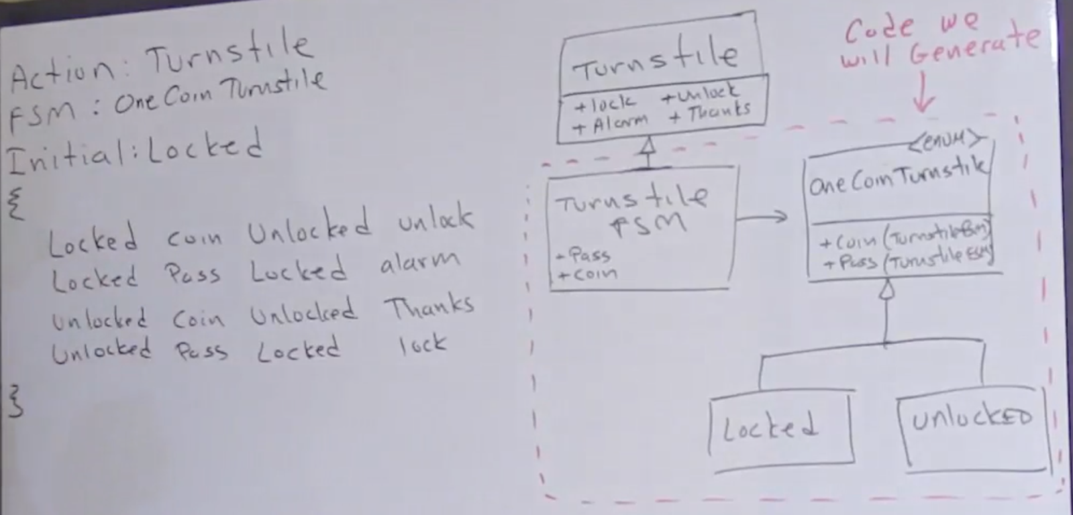
State Machine Compiler (SMC) - Parser
Here we aim to generate our state machine for the turnstile from our state table

Slide 3
State Machine Compiler (SMC) - Parser
Now we have the specification, we can create a formal spec using Backus-Naur Form – BNF.

Slide 4
Backus–Naur form (BNF)
Backus-Naur form is a metasyntax often used to describe the syntax of languages
//OneCoin
Actions: Turnstile
FSM: OneCoinTurnstile
Initial: Locked
{
Locked {
Coin Unlocked {alarmOff unlock}
Pass Locked alarmOn
}
Unlocked {
Coin Unlocked thankyou
Unlocked Pass Locked lock
}
}
FSM::=<Header>*<Logic>
<Header> ::= <Name> “:” <Name>
<Logic> ::= “{“ <Transition>* “}”
<Transition> ::= <State> “{“ <State-Spec> “}”
<State> ::= <Name>
<State-Spec> ::= <Event> ” ” <State> ” ” <Action>
<Event> ::= <Name>
<Action> ::= <Name> | “{“ <Name> “ ” <Action> “}”
<Name> ::= \w+
Headers

Slide 5
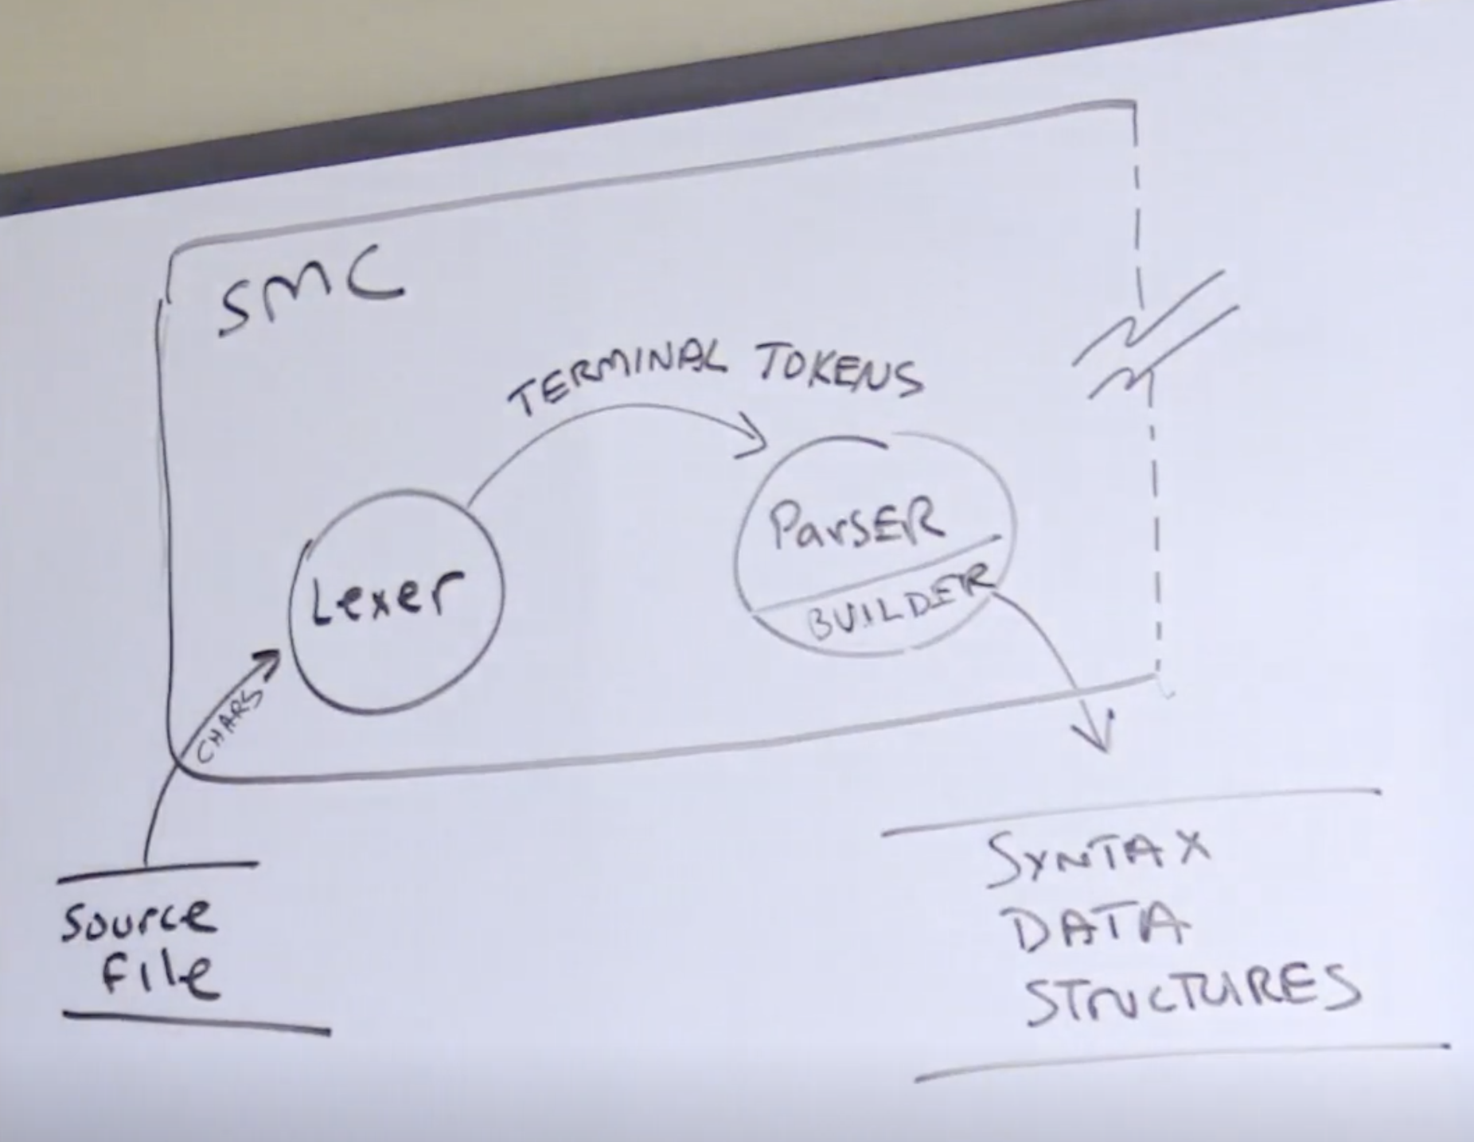
Lexical Analysis – Parsing our structure
Any system that can be represented in BNF can be parsed with a finite state machine
you can implement a parser by implementing the right finite state machine
Create the Lexer and then parse the structure string to create the data structures
The Data structures don’t know anything about the Lexer or the Parser

Slide 6
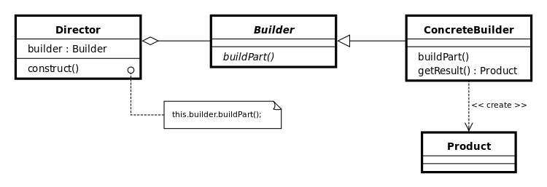
The Builder Pattern
The builder pattern separates the construction of a complex object from its representation so that the same construction process can create different representations

Slide 7
Basic builder pattern
public class Monkey { private String name; private int age; private Food food; // private constructor private Monkey() {} public static MonkeyBuilder builder() { return new MonkeyBuilder(); } @Override public String toString() { return "Monkey{" + "name='" + name + '\'' + ", age=" + age + ", food=" + food + '}'; } public static class MonkeyBuilder {}
public enum Food { BANANNA, APPLE } public static void main(String[] args) { Monkey monkey = Monkey.builder() .age(2) .name("Coco") .food(Food.APPLE) .build(); System.out.println("Monkey -> " + monkey); } }
public static class MonkeyBuilder { private String name; private int age; private Food food; public MonkeyBuilder name(String name) { this.name = name; return this; } public MonkeyBuilder age(int age) { this.age = age; return this; } public MonkeyBuilder food(Food food) { this.food = food; return this; } public Monkey build() { Monkey monkey = new Monkey(); monkey.name = this.name; monkey.age = this.age; monkey.food = this.food; return monkey; } }

Slide 8
Functional Builder
public class TestBuilder { public static void main(String[] args) { Customer bob = Customer.builderOf("bob", "smith") .withAddress("7 Beachamp Road") .withAge(68) .withPhoneNumber("7049653") .withSex(Customer.Sex.MALE) .build(); System.out.println(bob); Patient sam = Patient.builderOf("Sam", "Waldron") .with(builder -> { builder.age = 33; builder.address = ”59 Barns Lane"; builder.phoneNumber = "0118996722"; builder.sex = Patient.Sex.FEMALE; }).build(); System.out.println(sam); } }
Traditional Approach
Using Java8 Consumers

